Slide 1
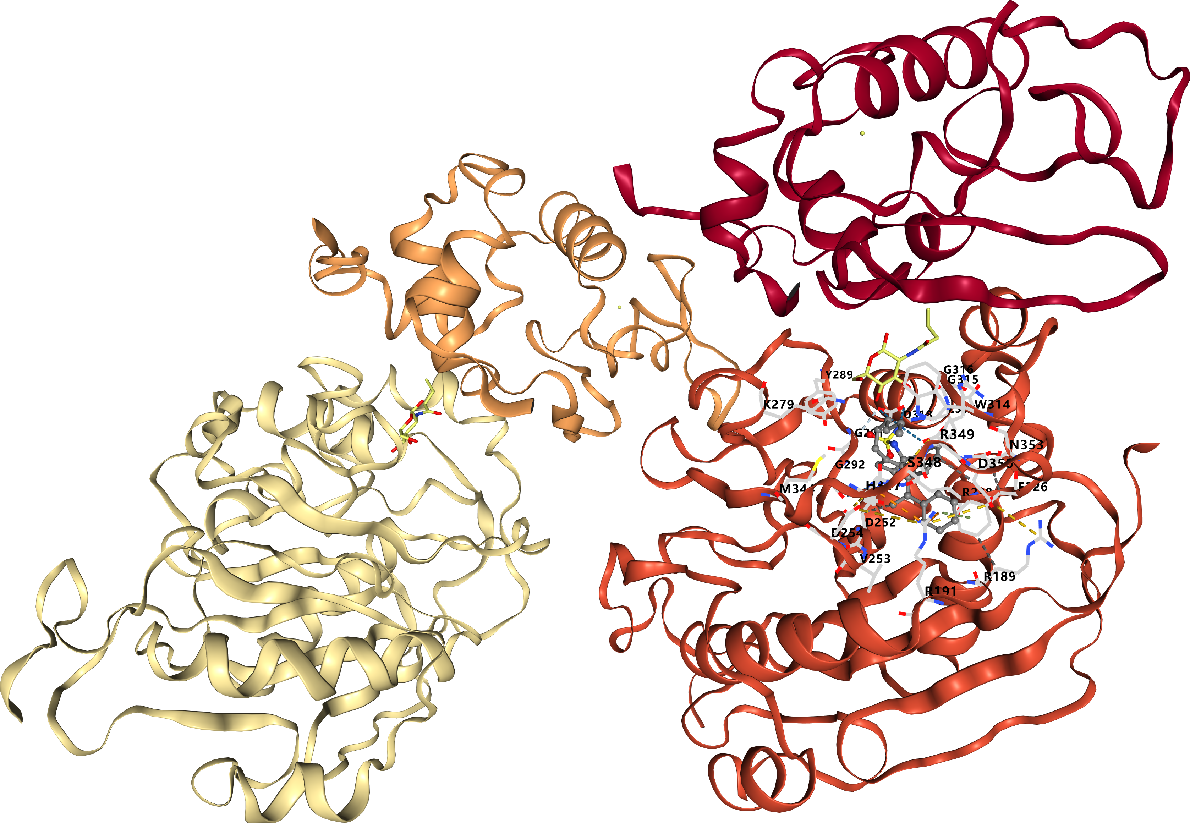
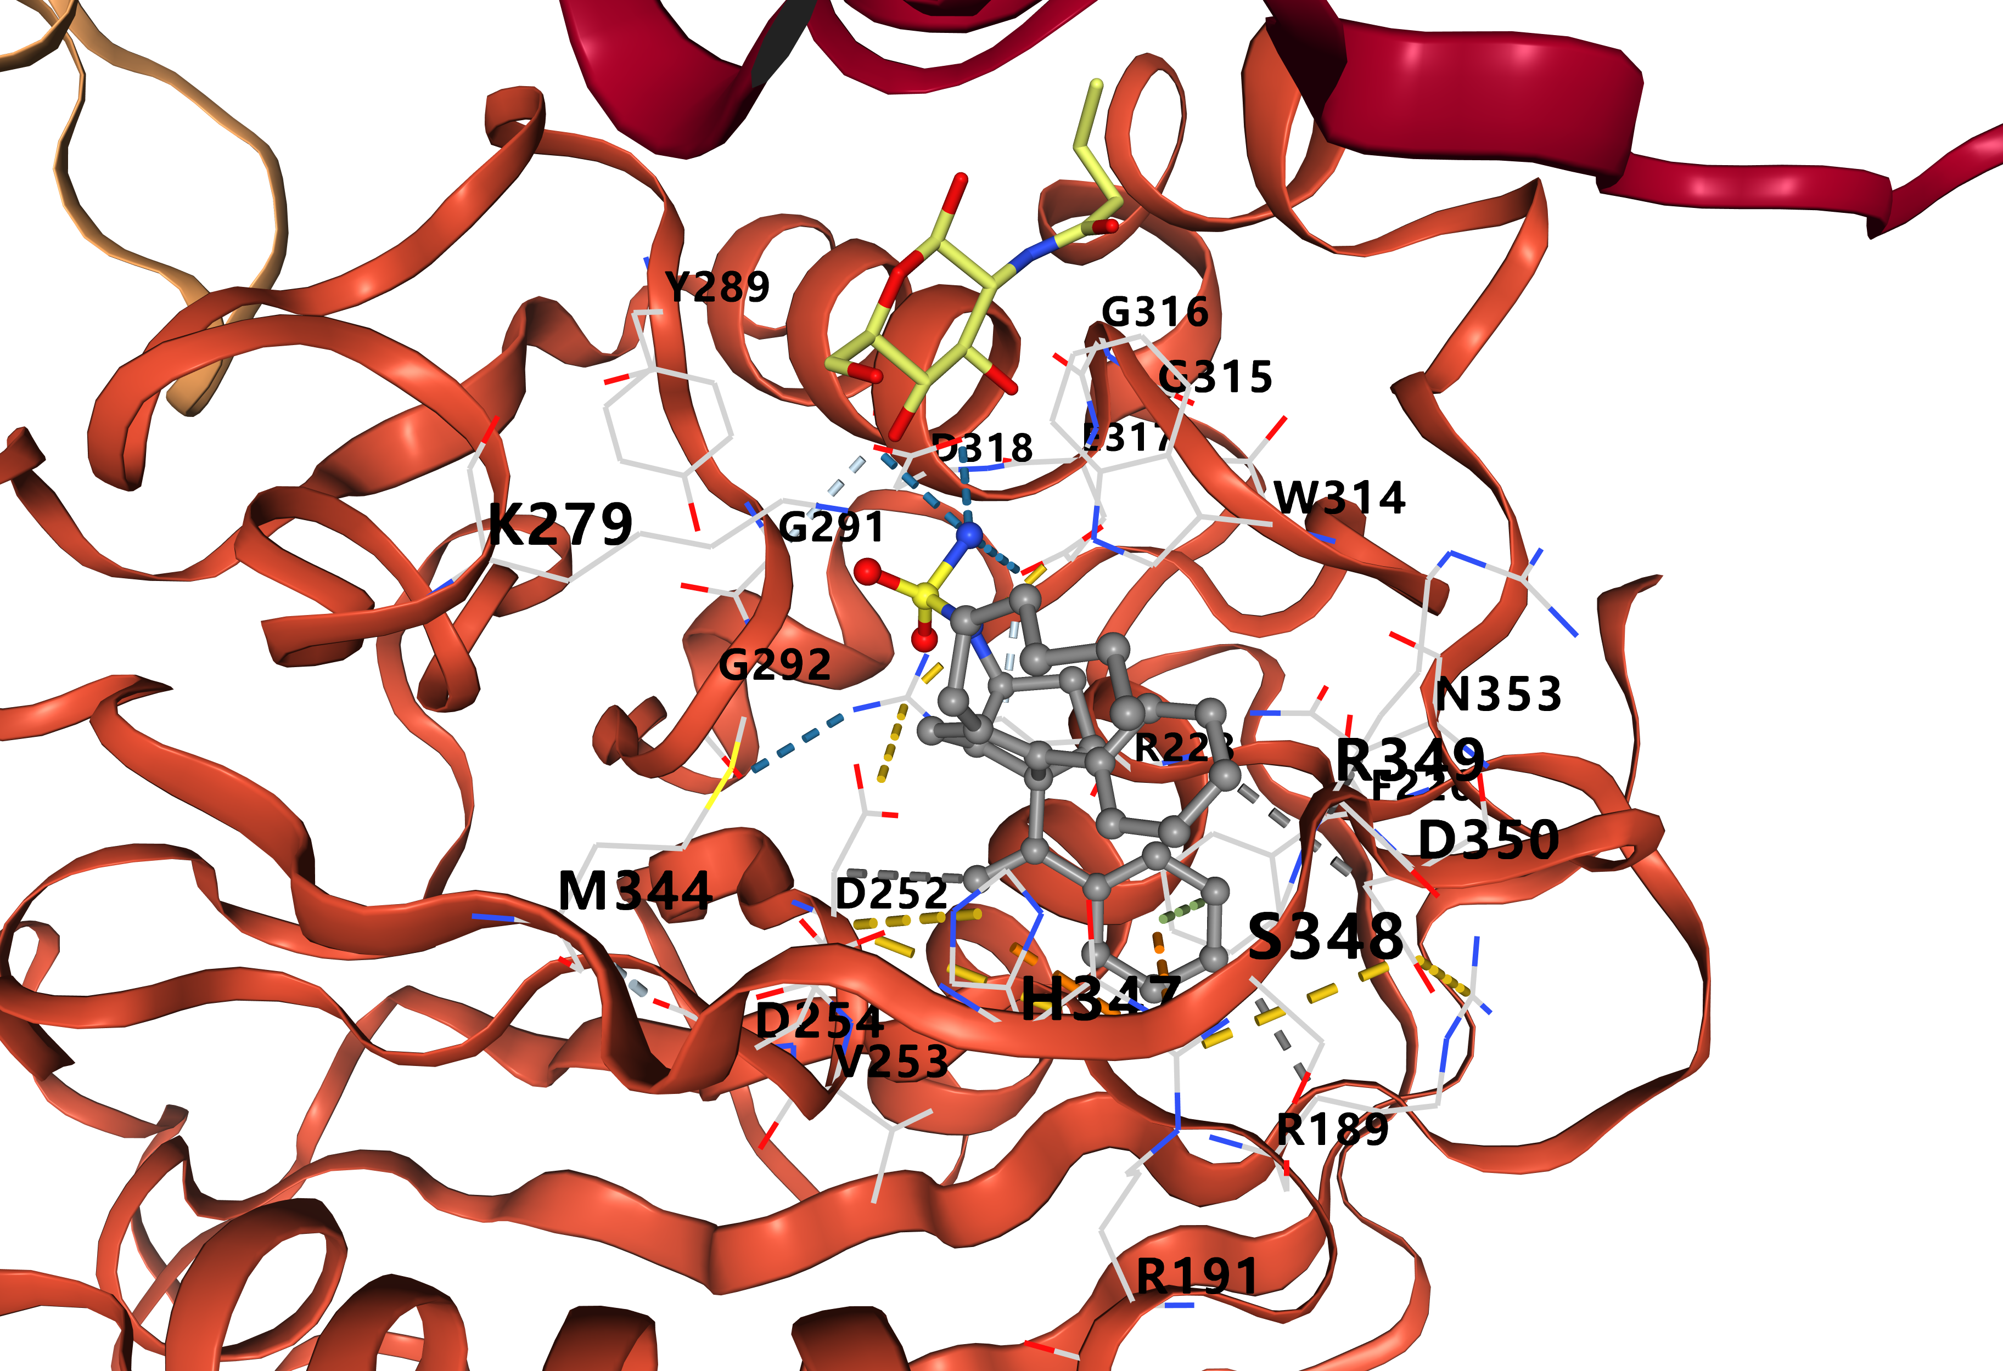
Vina Score: -8.4
COMPOUND 6N
[PMID: 31419141]

